Slide 1
Student Questions
Does the BOM reflect updated costs?
What is the best method to learn Onshape?
What else can it be used for?

Slide 2
Fluids questions
Are the walls within the flocculator that ensure proper mixing and particle collision considered flow control devices? I am just confused on the what the definition of a flow control device is.
Why does lower pressure mean more drag?
How does the orifice equation change for a hole that is not a circle (square or triangle shape for example)? Or is it the same?
Are we going to have assignments where we have to use all of these fluid mechanics equations/When will we use these equations

Slide 3
Fluids questions
How are turbidity and flow related?
Is it external and/or internal?
Is low viscosity ideal?
I think I'm confused on all the pressures and head losses that are considered when determining the flow through a pipe.
Notes:
Featurescript equations for pipe flow will help here!

Slide 4
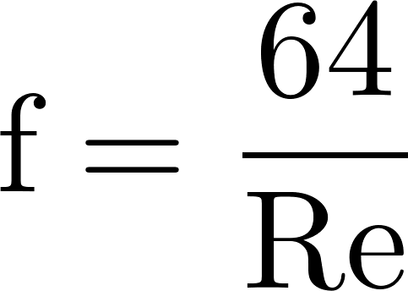
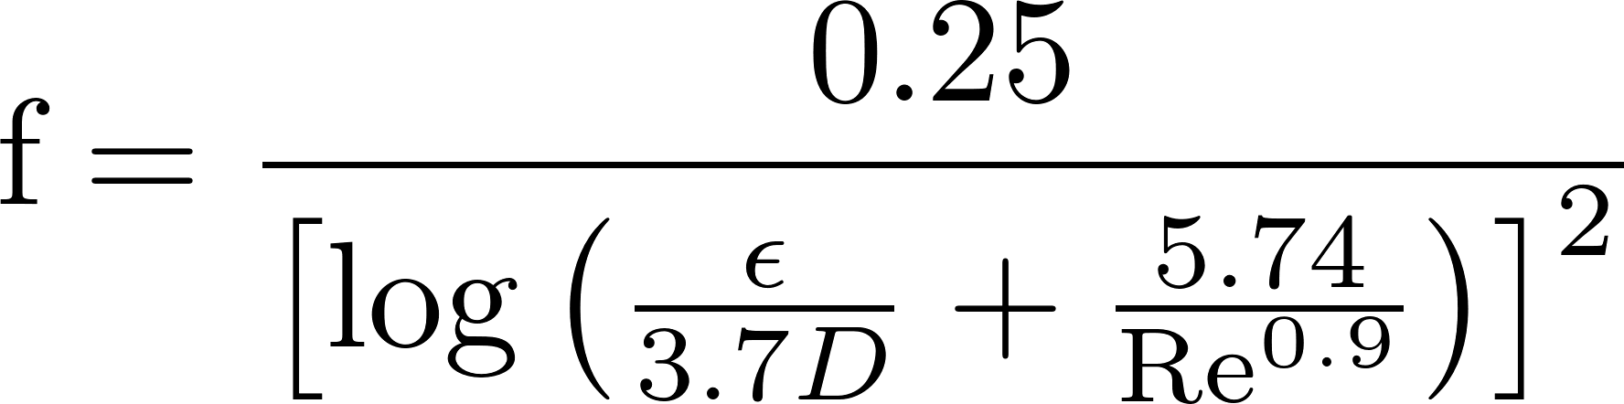
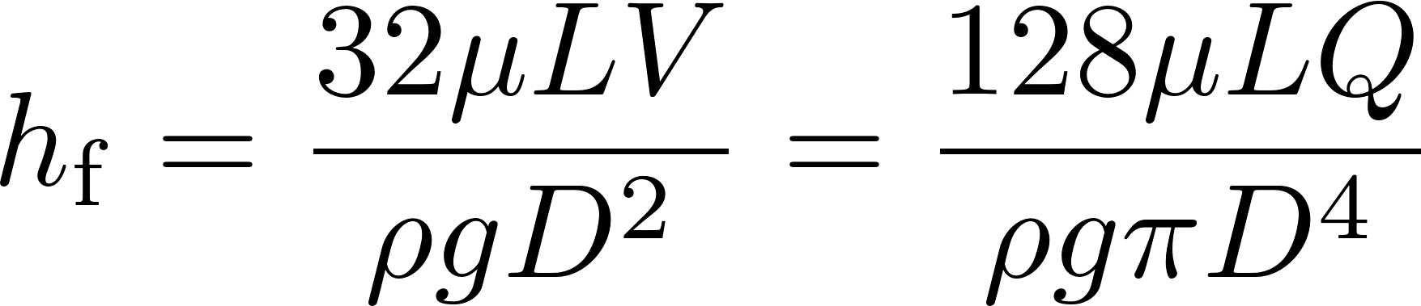
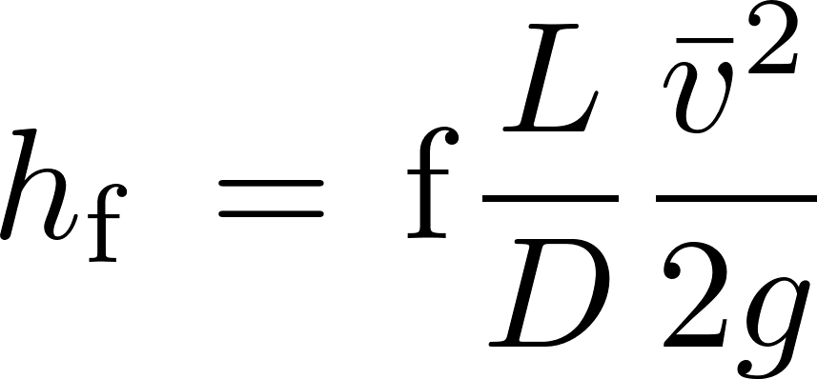
Head Loss in a Long STRAIGHT Tube (due to wall shear): Major Losses
Laminar
if Re < 2100,
Turbulent
if Re > 2100,
Swamee-Jain:
Major loss equation simplification
(for laminar flow only!):
Where Ɛ is the wall roughness
Hagen-Poiseuille:
(no h_{f} equation simplification😢)
h_{f} proportional flow

Slide 5
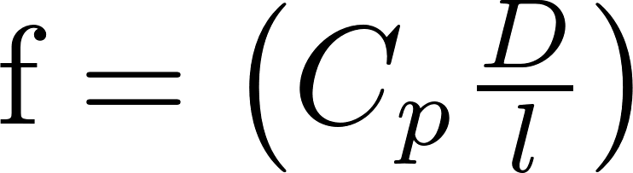
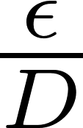
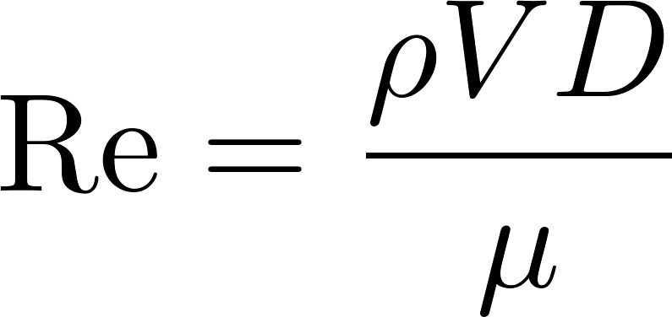
Frictional Losses in Straight Pipes: Moody Diagram
0.1
0.05
0.04
0.03
0.02
0.015
0.01
0.008
friction factor
0.006
0.004
laminar
0.002
0.001
0.0008
0.0004
0.0002
0.0001
0.01
0.00005
smooth
1E+03
1E+04
1E+05
1E+06
1E+07
1E+08
Re

Slide 6
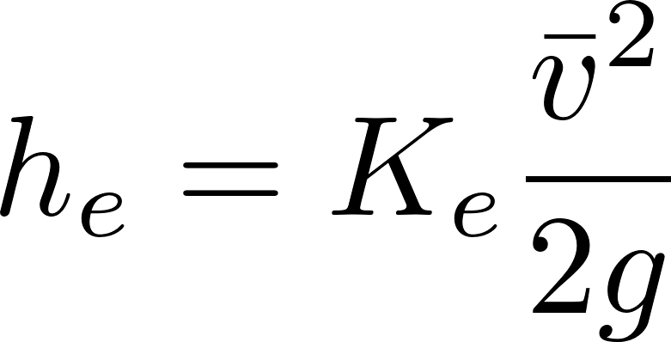
Two Tanks are connected with a pipe
Current flow rate is Q
Pipe diameter is 1”
Downstream tank water surface is 1 m lower than the upstream tank water surface
You may assume
the flow is turbulent (high Reynolds Number)
the pipe walls are rough
The pipe length/diameter is large enough that major losses dominate

Slide 7
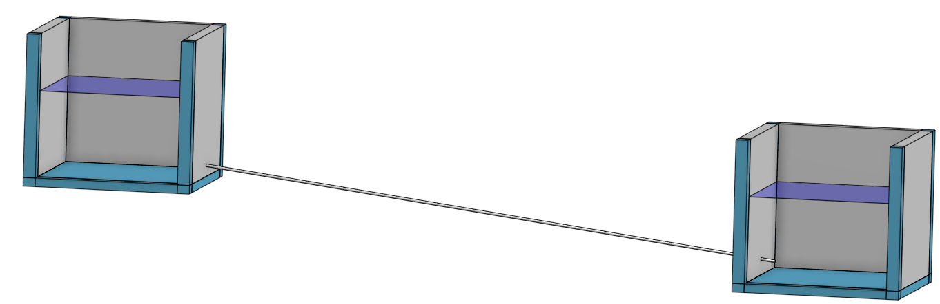
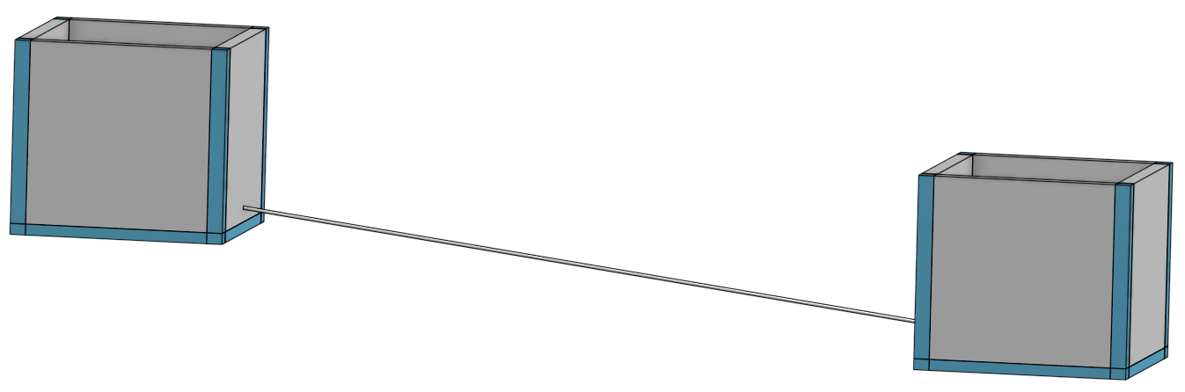
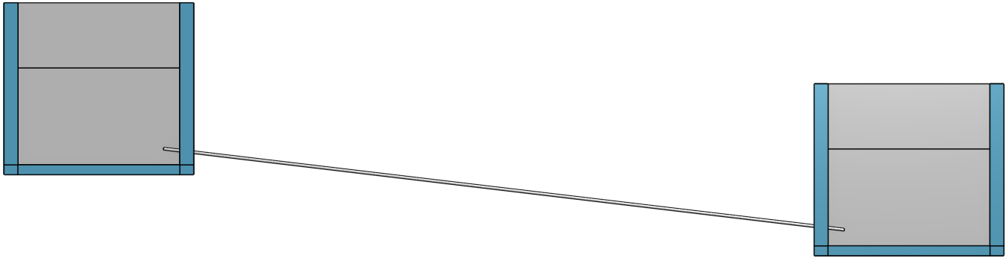
Long pipe connecting two tanks (Onshape model)
Estimate APPROXIMATELY (no calculators!) how much further must I lower the downstream tank to double the flow rate? (assume the pipe remains the same length!)
1 m
Q
Notes:
breakout rooms, with 3 people
Give them 5 minutes to solve the problem
one person from breakout room type answer in the chat
Then walk through the solution

Slide 8
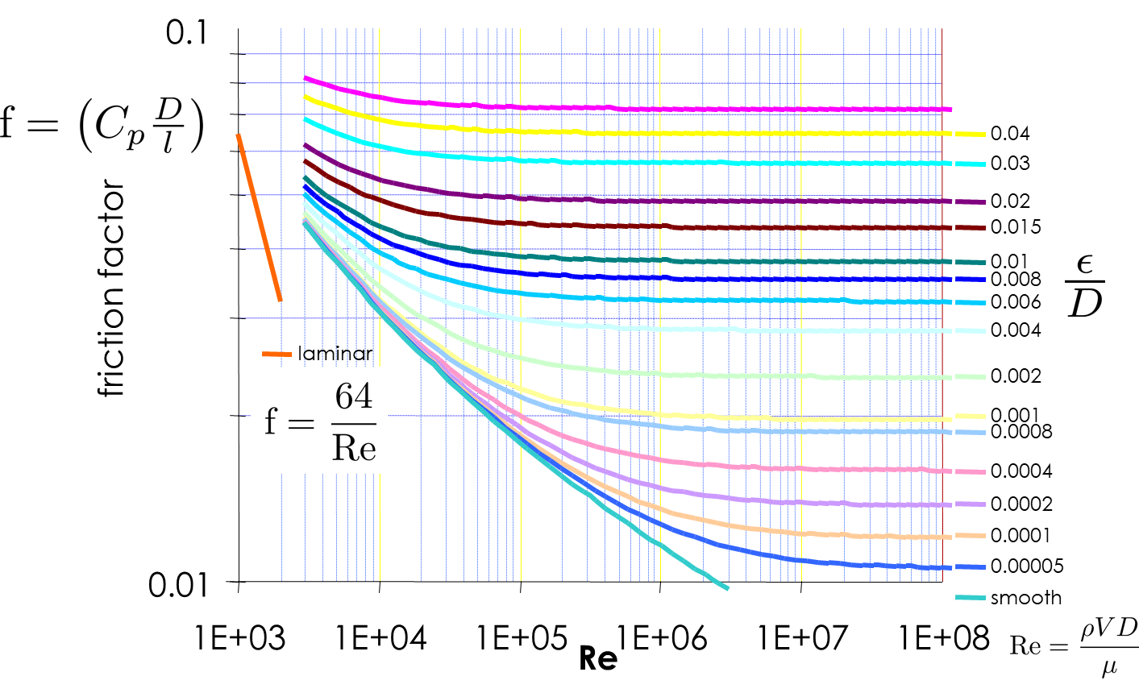
Head loss through a long, rough pipe with turbulent flow
Decreases with increased flow
Remains constant with increased flow
Increases approximately in proportion to the flow
Increases approximately in proportion to the square of the flow
Increases in proportion to the natural log of the flow

Slide 9
Demo creating the two tanks with a pipe
Use simple part studio (no featurescript)
Use config for head loss
Create two civil tanks separated by x=10 m, z=-1 m using mate connector
Sketch pipe that is 20 cm into tanks and 20 cm off the bottom
Create pipeline
Add holes
Paint it for fun

